Slide 1

EE902 - EE908 - Convex Optimization SPCOM
eMasters – Q4-2023-24 – Mar-Apr-2024
IIT Kanpur
Venkateswar Reddy Melachervu
CTO
11th Apr 2024
Brillium Technologies
#501, C Block, Salarpuria Serenity, 5th Main, Sector 7, HSR Layout, Bengaluru 560102, Karnataka, India
Website: www.brillium.in | Email: connect@brillium.in

Slide 2
EE902 Course Objectives
Convex optimization has recently been applied to a wide variety of problems in EE, especially in signal processing, communications, and networks.
The aim of this course is to train the students in application and analysis of convex optimization problems in signal processing and wireless communications. At the end of this course, the students are expected to:
  Know about the applications of convex optimization in signal processing, wireless communications, and networking research.
  Be able to recognize convex optimization problems arising in these areas.
  Be able to recognize ‘hidden’ convexity in many seemingly non-convex problems; formulate them as convex problems.
  Be able to develop low-complexity, approximate solutions for difficult non-convex problems.

Slide 3
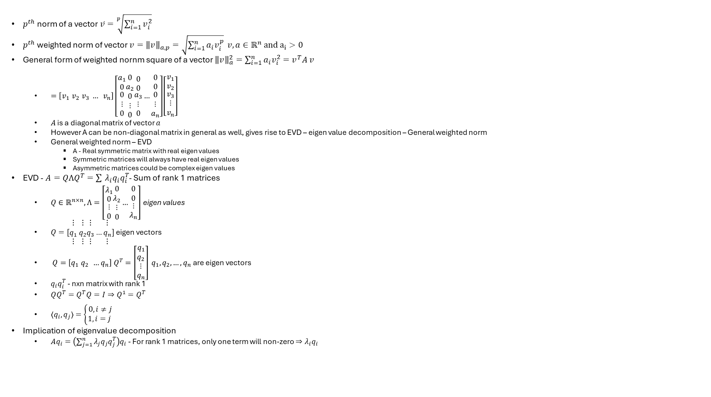
EVD
$p^{th}$ norm of a vector $\overline{v}=\sqrt[p]{\sum_{i=1}^{n}{v_{i}^{2}}}$
$p^{th}$ weighted norm of vector $v={\left\|v\right\|}_{a,p}=\sqrt{\sum_{i=1}^{n}{a_{i}v_{i}^{p}}} v,a∈ℝ^{n} and a_{i}>0$
General form of weighted nornm square of a vector ${\left\|v\right\|}_{a}^{2}={\sum_{i=1}^{n}{a_{i}v_{i}^{2}}=v}^{T}A v$
  $=\left[v_{1} v_{2} v_{3} … v_{n}\right]\left[\begin{matrix}a_{1} \\ 0 \\ \begin{aligned}0 \\ ⋮ \\ 0\end{aligned}\end{matrix}\begin{matrix}0 \\ a_{2} \\ \begin{aligned}0 \\ ⋮ \\ 0\end{aligned}\end{matrix}\begin{matrix}0 \\ 0 \\ \begin{aligned}a_{3} \\ ⋮ \\ 0\end{aligned}\end{matrix}…\begin{matrix}0 \\ 0 \\ \begin{aligned}0 \\ ⋮ \\ a_{n}\end{aligned}\end{matrix}\right]\left[\begin{matrix}v_{1} \\ v_{2} \\ \begin{aligned}v_{3} \\ ⋮ \\ v_{n}\end{aligned}\end{matrix}\right]$
  $A$ is a diagonal matrix of vector $a$
  However A can be non-diagonal matrix in general as well, gives rise to EVD – eigen value decomposition – General weighted norm
  General weighted norm – EVD
    A - Real symmetric matrix with real eigen values
    Symmetric matrices will always have real eigen values
    Asymmetric matrices could be complex eigen values
EVD - $A=QΛQ^{T}=\sum_{ }^{ }{λ_{i}q_{i}q_{i}^{T}}$- Sum of rank 1 matrices
  $Q∈ℝ^{n×n}, Λ=\left[\begin{matrix}λ_{1} \\ 0 \\ \begin{aligned}⋮ \\ 0\end{aligned}\end{matrix}\begin{matrix}0 \\ λ_{2} \\ \begin{aligned}⋮ \\ 0\end{aligned}\end{matrix}…\begin{matrix}0 \\ 0 \\ \begin{aligned}⋮ \\ λ_{n}\end{aligned}\end{matrix}\right]$ eigen values
  $Q=[\begin{matrix}⋮ \\ q_{1} \\ ⋮\end{matrix} \begin{matrix}⋮ \\ q_{2} \\ ⋮\end{matrix}\begin{matrix}⋮ \\ q_{3} \\ ⋮\end{matrix}…\begin{matrix}⋮ \\ q_{n} \\ ⋮\end{matrix}]$ eigen vectors
  $Q=\left[q_{1} q_{2} …q_{n}\right] Q^{T}=\left[\begin{matrix}q_{1} \\ q_{2} \\ \begin{aligned}⋮ \\ q_{n}\end{aligned}\end{matrix}\right] q_{1}, q_{2}, …, q_{n}$ are eigen vectors
  $q_{i}q_{i}^{T}$ - nxn matrix with rank 1
  $QQ^{T}=Q^{T}Q=I⇒Q^{1}=Q^{T}$
  $〈q_{i}, q_{j}〉=\left\{\begin{aligned}0, i≠j \\ 1, i=j \end{aligned}\right.$
Implication of eigenvalue decomposition
  $Aq_{i}=\left(\sum_{j=1}^{n}{λ_{j}q_{j}q_{j}^{T}}\right)q_{i}$ - For rank 1 matrices, only one term will non-zero $⇒λ_{i}q_{i}$

Slide 4
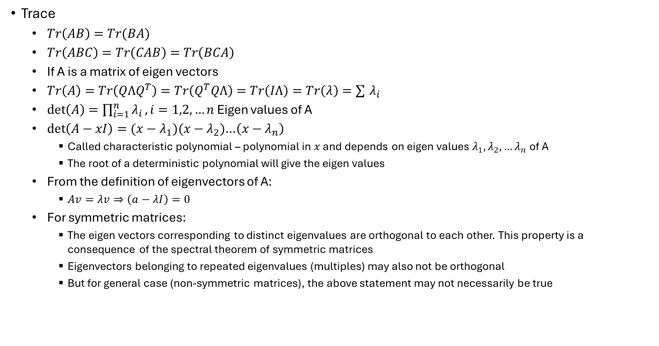
EVD
Trace
  $Tr\left(AB\right)=Tr(BA)$
  $Tr\left(ABC\right)=Tr\left(CAB\right)=Tr\left(BCA\right)$
  If A is a matrix of eigen vectors
  $Tr\left(A\right)=Tr\left(QΛQ^{T}\right)=Tr\left(Q^{T}QΛ\right)=Tr\left(IΛ\right)=Tr\left(λ\right)=\sum_{ }^{ }{λ_{i}}$
  $\det\left(A\right)=\prod_{i=1}^{n}{λ_{i}}, i=1,2,…n$ Eigen values of A
  $\det\left(A−xI\right)=(x−λ_{1})(x−λ_{2})$…$\left(x−λ_{n}\right)$
    Called characteristic polynomial – polynomial in $x$ and depends on eigen values $λ_{1}, λ_{2},…λ_{n}$ of A
    The root of a deterministic polynomial will give the eigen values
  From the definition of eigenvectors of A:
    $Av=λv⇒\left(a−λI\right)=0$
  For symmetric matrices:
    The eigen vectors corresponding to distinct eigenvalues are orthogonal to each other. This property is a consequence of the spectral theorem of symmetric matrices
    Eigenvectors belonging to repeated eigenvalues (multiples) may also not be orthogonal
    But for general case (non-symmetric matrices), the above statement may not necessarily be true

Slide 5
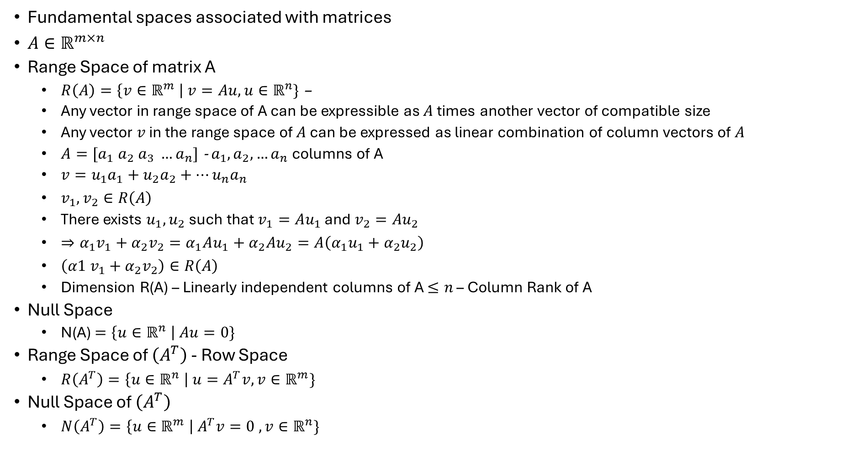
Fundamental Spaces of A Matrix
Fundamental spaces associated with matrices
$A∈ℝ^{m×n}$
Range Space of matrix A
  $R\left(A\right)=\left\{v∈ℝ^{m} \right| v=Au, u∈ℝ^{n}\}$ –
  Any vector in range space of A can be expressible as $A$ times another vector of compatible size
  Any vector $v$ in the range space of $A$ can be expressed as linear combination of column vectors of $A$
  $A=[a_{1} a_{2} a_{3} …a_{n}]$ - $a_{1}, a_{2}, …a_{n}$ columns of A
  $v=u_{1}a_{1}+u_{2}a_{2}+…u_{n}a_{n}$
  $v_{1}, v_{2}∈R\left(A\right)$
  There exists $u_{1},u_{2}$such that $v_{1}=Au_{1}$ and $v_{2}=Au_{2}$
  $⇒α_{1}v_{1}+α_{2}v_{2}=α_{1}Au_{1}+α_{2}Au_{2}=A\left(α_{1}u_{1}+α_{2}u_{2}\right)$
  $\left(α1 v_{1}+α_{2}v_{2}\right)∈R\left(A\right)$
  Dimension R(A) – Linearly independent columns of A $≤n$ – Column Rank of A
Null Space
  N(A) $=\left\{u∈ℝ^{n} \right| Au=0\}$
Range Space of $\left(A^{T}\right)$ - Row Space
  $R\left(A^{T}\right)=\left\{u∈ℝ^{n} \right| u=A^{T}v, v∈ℝ^{m}\}$
Null Space of $\left(A^{T}\right)$
  $N\left(A^{T}\right)=\left\{u∈ℝ^{m} \right| A^{T}v=0 , v∈ℝ^{n}\}$

Slide 6
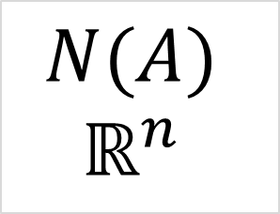
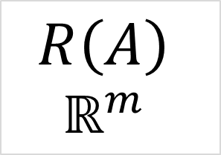
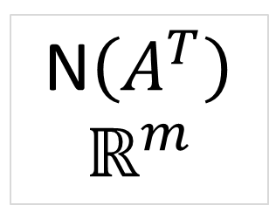
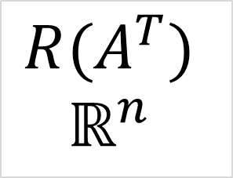
Fundamental Spaces of A Matrix
$$R(A^{T})$$
$$ℝ^{n}$$
$$R\left(A\right)$$
$$ℝ^{m}$$
A
$$N(A)$$
$$ℝ^{n}$$
N$\left(A^{T}\right)$
$$ℝ^{m}$$

Slide 7
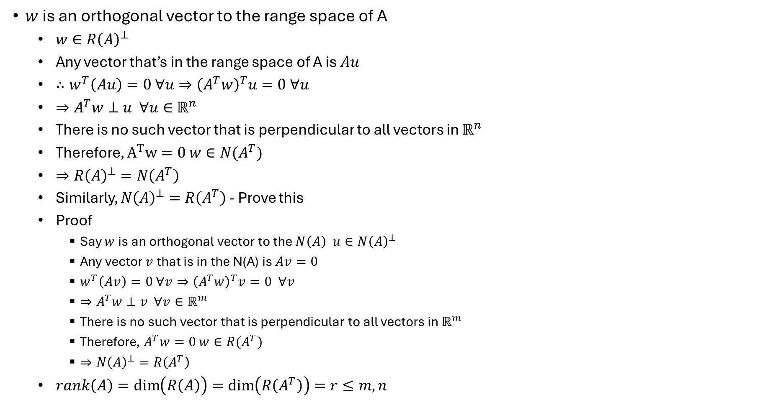
Fundamental Spaces of A Matrix
$w$ is an orthogonal vector to the range space of A
  $w∈R{\left(A\right)}^{⊥}$
  Any vector that’s in the range space of A is $Au$
  $∴w^{T}\left(Au\right)=0 ∀u⇒{\left(A^{T}w\right)}^{T}u=0 ∀u$
  $⇒A^{T}w⊥u ∀u∈ℝ^{n}$
  There is no such vector that is perpendicular to all vectors in $ℝ^{n}$
  Therefore, $A^{T}w=0$ $w∈N(A^{T})$
  $⇒R{\left(A\right)}^{⊥}=N\left(A^{T}\right)$
  Similarly, $N{\left(A\right)}^{⊥}=R\left(A^{T}\right)$ - Prove this
  Proof
    Say $w$ is an orthogonal vector to the $N\left(A\right) u∈N{\left(A\right)}^{⊥}$
    Any vector $v$that is in the N(A) is $Av=0$
    $w^{T}\left(Av\right)=0 ∀v⇒{\left(A^{T}w\right)}^{T}v=0 ∀v$
    $⇒A^{T}w⊥v ∀v∈ℝ^{m}$
    There is no such vector that is perpendicular to all vectors in $ℝ^{m}$
    Therefore, $A^{T}w=0$ $w∈R(A^{T})$
    $⇒N{\left(A\right)}^{⊥}=R\left(A^{T}\right)$
  $rank\left(A\right)=\dim\left(R\left(A\right)\right)=\dim\left(R\left(A^{T}\right)\right)=r≤m, n$

Slide 8
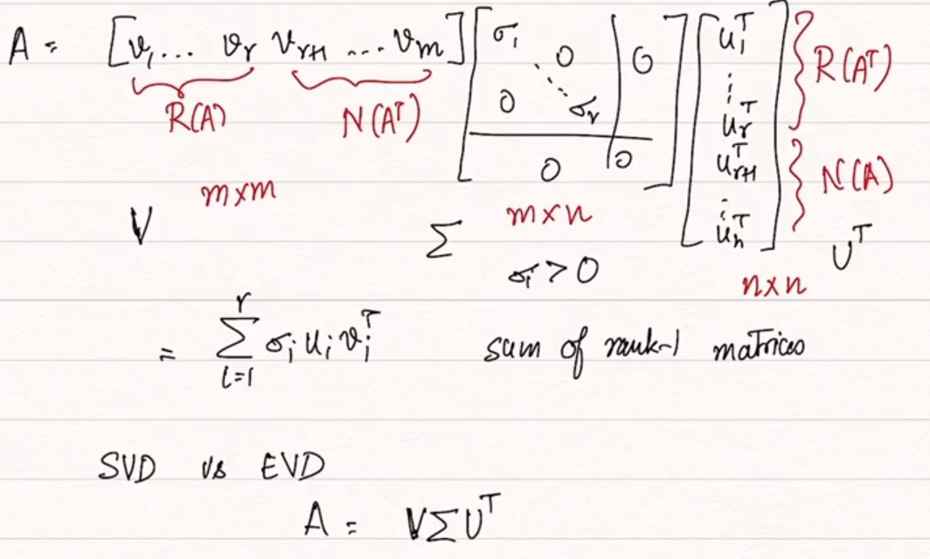
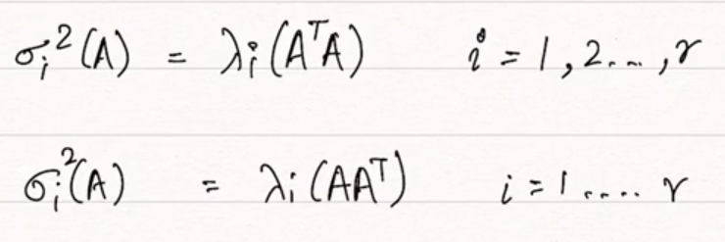
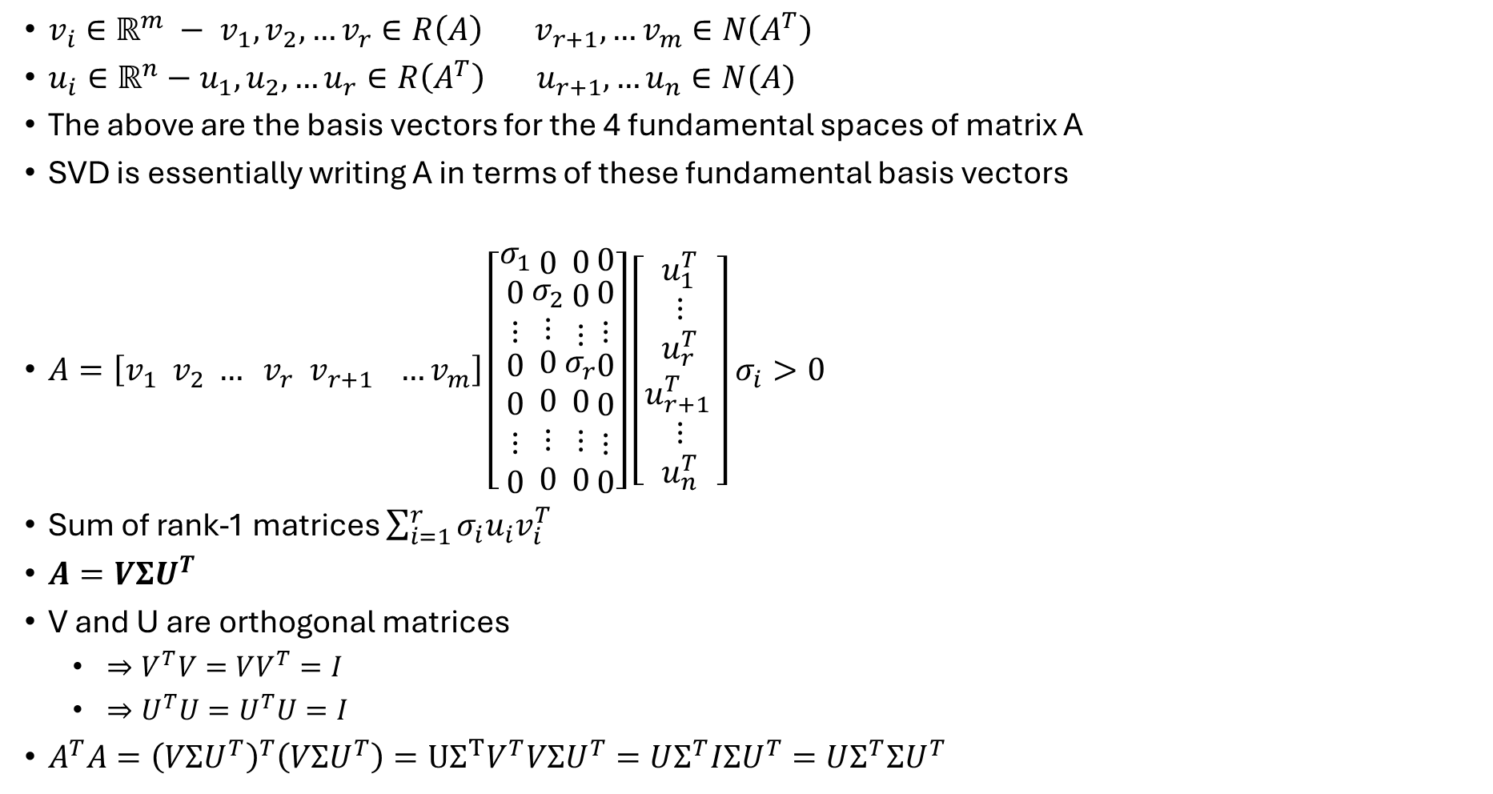
SVD
$v_{i}∈ℝ^{m} − v_{1}, v_{2},…v_{r}∈R\left(A\right) v_{r+1},…v_{m}∈N\left(A^{T}\right)$
$u_{i}∈ℝ^{n}−u_{1},u_{2},…u_{r}∈R\left(A^{T}\right) u_{r+1}, …u_{n}∈N(A)$
The above are the basis vectors for the 4 fundamental spaces of matrix A
SVD is essentially writing A in terms of these fundamental basis vectors
$A=\left[v_{1} v_{2} … v_{r} v_{r+1 } …v_{m}\right]\left[\begin{matrix}σ_{1} \\ \begin{aligned}0 \\ ⋮\end{aligned} \\ \begin{aligned}0 \\ 0 \\ ⋮ \\ 0\end{aligned}\end{matrix}\begin{matrix}0 \\ \begin{aligned}σ_{2} \\ ⋮\end{aligned} \\ \begin{aligned}0 \\ 0 \\ ⋮ \\ 0\end{aligned}\end{matrix}\begin{matrix}0 \\ \begin{aligned}0 \\ ⋮\end{aligned} \\ \begin{aligned}σ_{r} \\ 0 \\ ⋮ \\ 0\end{aligned}\end{matrix}\begin{matrix}0 \\ \begin{aligned}0 \\ ⋮\end{aligned} \\ \begin{aligned}0 \\ 0 \\ ⋮ \\ 0\end{aligned}\end{matrix}\right]\left[\begin{matrix}u_{1}^{T} \\ \begin{aligned}⋮ \\ u_{r}^{T}\end{aligned} \\ \begin{aligned}u_{r+1 }^{T} \\ ⋮ \\ u_{n}^{T}\end{aligned}\end{matrix}\right]$ $σ_{i}>0$
Sum of rank-1 matrices $\sum_{i=1}^{r}{σ_{i}u_{i}v_{i}^{T}}$
$A=VΣU^{T}$
V and U are orthogonal matrices
  $⇒V^{T}V=VV^{T}=I$
  $⇒U^{T}U=U^{T}U=I$
$A^{T}A={\left(VΣU^{T}\right)}^{T}\left(VΣU^{T}\right)=UΣ^{T}V^{T}VΣU^{T}=UΣ^{T}IΣU^{T}=UΣ^{T}ΣU^{T}$

Slide 9
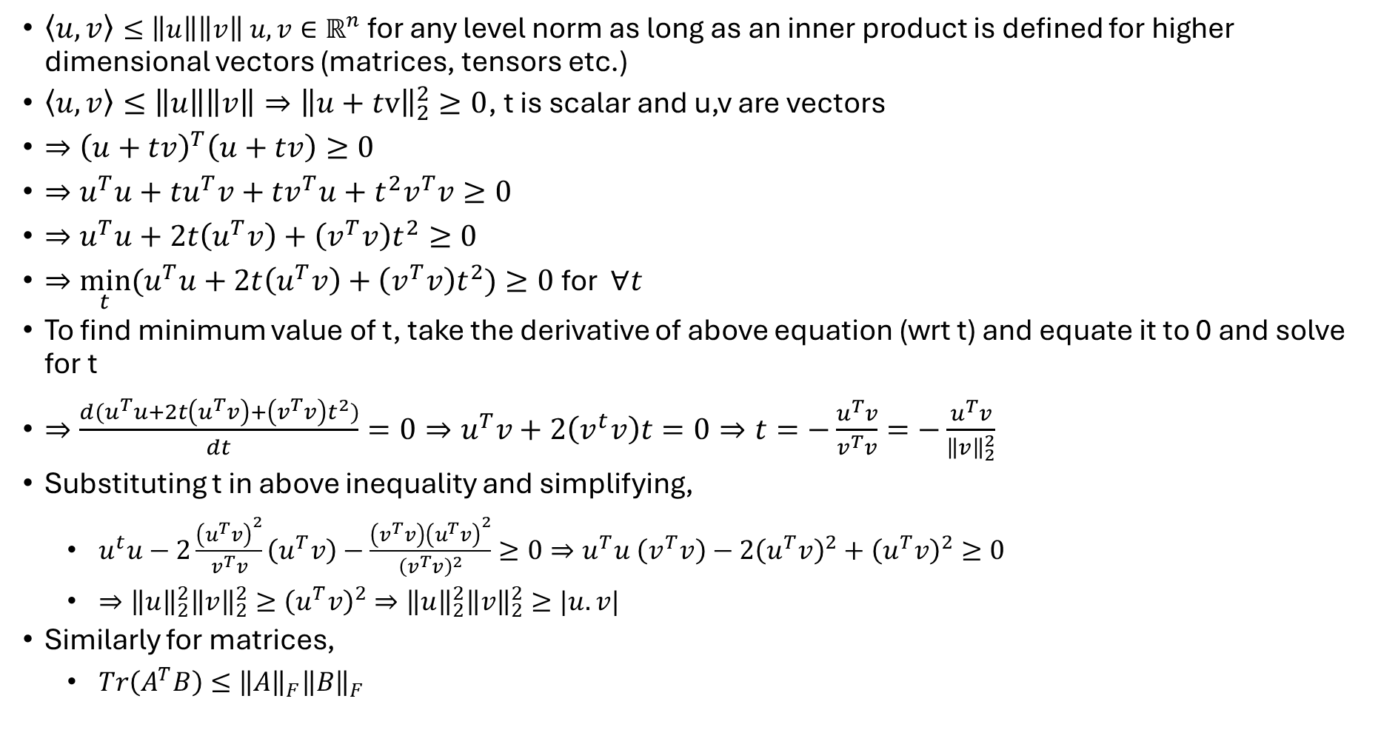
Cauchy Schwartz Inequality
$〈u,v〉≤\left\|u\right\|\left\|v\right\| u,v∈ℝ^{n}$ for any level norm as long as an inner product is defined for higher dimensional vectors (matrices, tensors etc.)
$〈u,v〉≤\left\|u\right\|\left\|v\right\|⇒{\left\|u+tv\right\|}_{2}^{2}≥0$, t is scalar and u,v are vectors
$⇒{\left(u+tv\right)}^{T}\left(u+tv\right)≥0$
$⇒u^{T}u+tu^{T}v+tv^{T}u+t^{2}v^{T}v≥0$
$⇒u^{T}u+2t\left(u^{T}v\right)+\left(v^{T}v\right)t^{2}≥0$
$⇒\min_{t}{(u^{T}u+2t\left(u^{T}v\right)+\left(v^{T}v\right)t^{2})}≥0$ for $∀t$
To find minimum value of t, take the derivative of above equation (wrt t) and equate it to 0 and solve for t
$⇒\frac{d(u^{T}u+2t\left(u^{T}v\right)+\left(v^{T}v\right)t^{2})}{dt}=0⇒u^{T}v+2\left(v^{t}v\right)t=0⇒t=−\frac{u^{T}v}{v^{T}v}=−\frac{u^{T}v}{{\left\|v\right\|}_{2}^{2}}$
Substituting t in above inequality and simplifying,
  $u^{t}u−2\frac{{\left(u^{T}v\right)}^{2}}{v^{T}v}\left(u^{T}v\right)−\frac{\left(v^{T}v\right){\left(u^{T}v\right)}^{2}}{{\left(v^{T}v\right)}^{2}}≥0⇒u^{T}u \left(v^{T}v\right)−2{\left(u^{T}v\right)}^{2}+{\left(u^{T}v\right)}^{2}≥0$
  $⇒{\left\|u\right\|}_{2}^{2}{\left\|v\right\|}_{2}^{2}≥{\left(u^{T}v\right)}^{2}⇒{\left\|u\right\|}_{2}^{2}{\left\|v\right\|}_{2}^{2}≥|u.v|$
Similarly for matrices,
  $Tr\left(A^{T}B\right)≤{\left\|A\right\|}_{F}{\left\|B\right\|}_{F}$

Slide 10
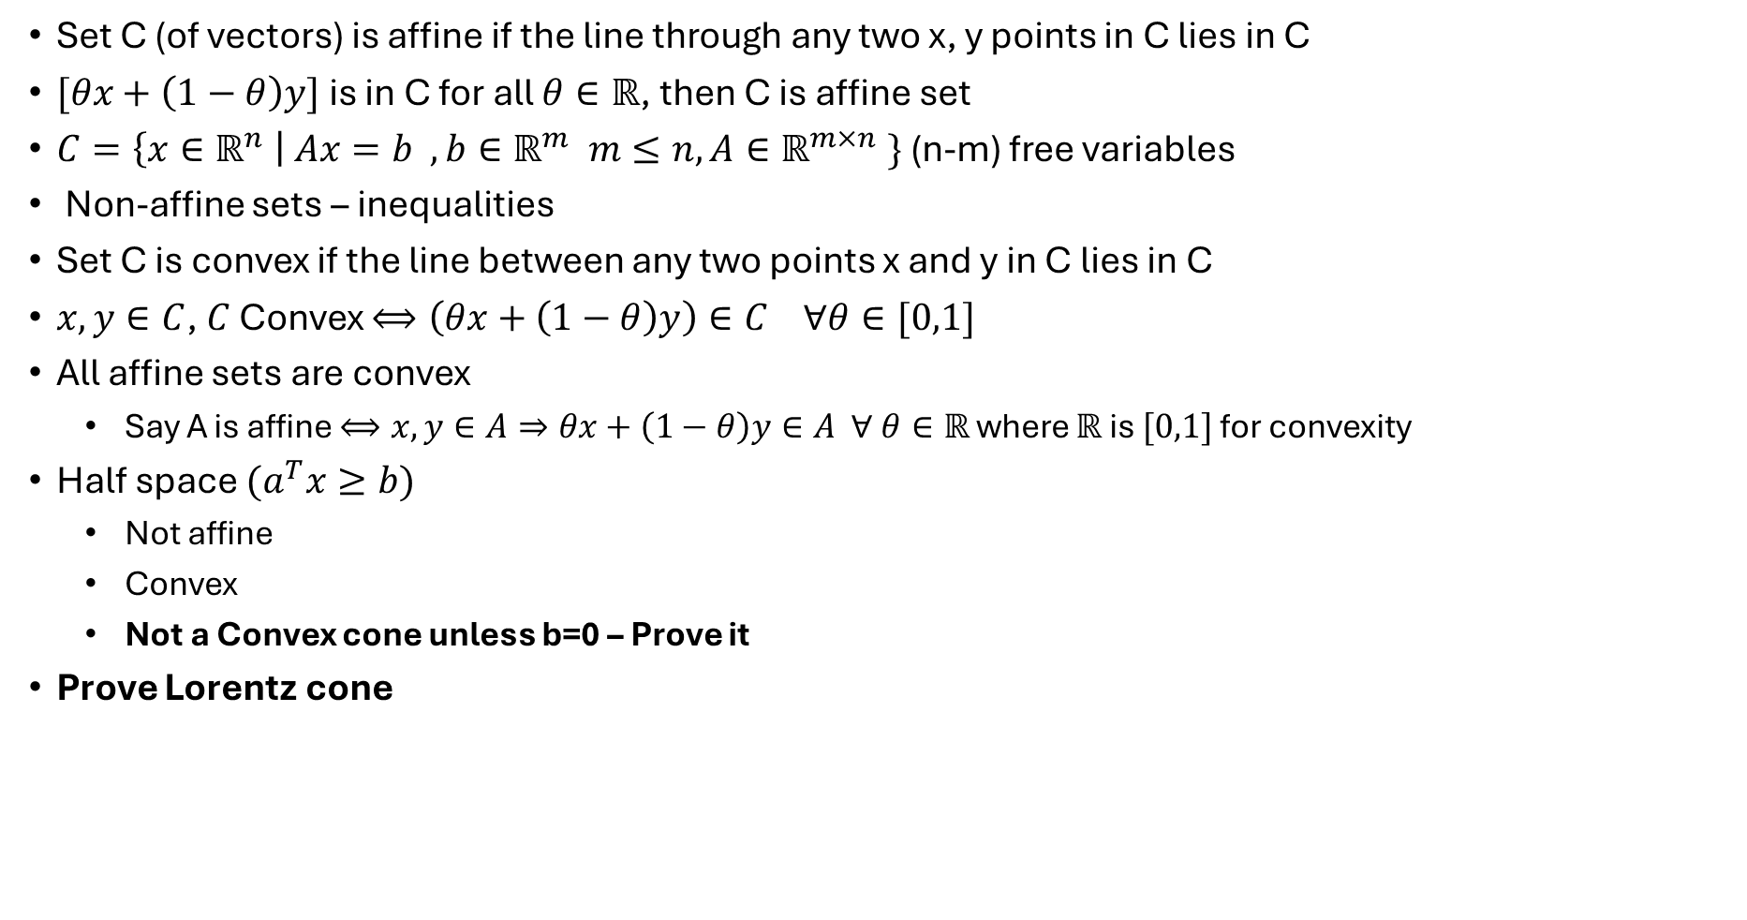
Convex Sets – Affine Sets
Set C (of vectors) is affine if the line through any two x, y points in C lies in C
$[θx+\left(1−θ\right)y]$ is in C for all $θ∈ℝ$, then C is affine set
$C=\left\{x∈ℝ^{n} \right| Ax=b , b∈ℝ^{m} m≤n, A∈ℝ^{m×n} \}$ (n-m) free variables
Non-affine sets – inequalities
Set C is convex if the line between any two points x and y in C lies in C
$x,y∈C$, $C$ Convex $⟺\left(θx+\left(1−θ\right)y\right)∈C ∀θ∈[0,1]$
All affine sets are convex
  Say A is affine $⟺x,y∈A⇒θx+\left(1−θ\right)y∈A ∀ θ∈ℝ$ where $ℝ$ is $[0,1]$ for convexity
Half space $(a^{T}x≥b)$
  Not affine
  Convex
  Not a Convex cone unless b=0 – Prove it
Prove Lorentz cone

Slide 11
Thank you
Brillium Technologies
#501, C Block, Salarpuria Serenity, 5th Main, Sector 7, HSR Layout, Bengaluru 560102, Karnataka, India
Website: www.brillium.in | Email: connect@brillium.in

